Slide 1



LIR Dashboard
View in Power BI
Last data refresh:
10/22/2021 4:20:37 PM UTC
Downloaded at:
10/22/2021 4:23:03 PM UTC

Slide 2
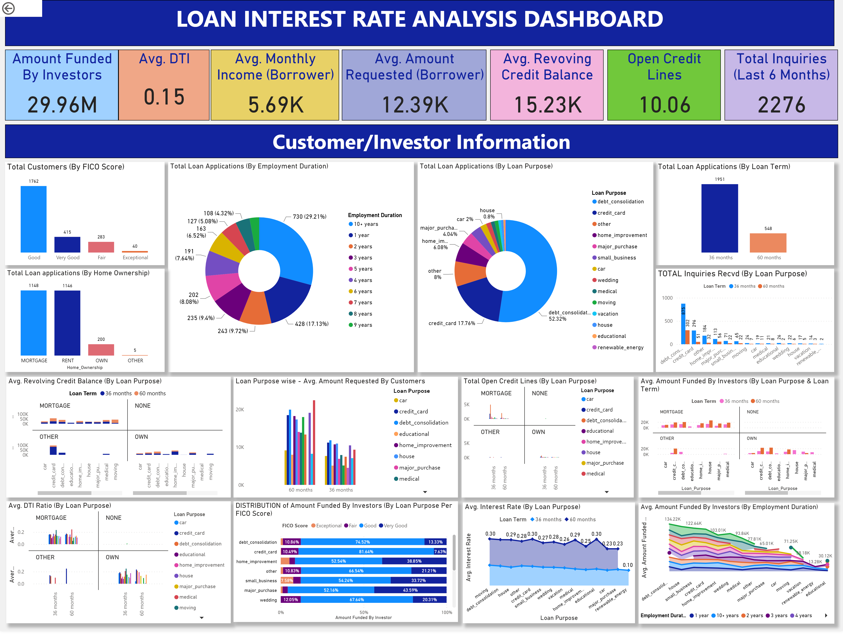
Page 1
Notes:
textbox
No alt text provided.
Amount Funded By Investors
No alt text provided.
Avg. DTI
No alt text provided.
Avg. Monthly Income (Borrower)
No alt text provided.
Avg. Amount Requested (Borrower)
No alt text provided.
Avg. Revoving Credit Balance
No alt text provided.
Open Credit Lines
No alt text provided.
Total Inquiries (Last 6 Months)
No alt text provided.
actionButton
No alt text provided.
Total Customers (By FICO Score)
No alt text provided.
Total Loan Applications (By Employment Duration)
No alt text provided.
Total Loan Applications (By Loan Term)
No alt text provided.
Total Loan Applications (By Loan Purpose)
No alt text provided.
Total Loan applications (By Home Ownership)
No alt text provided.
textbox
No alt text provided.
Avg. Revolving Credit Balance (By Loan Purpose)
No alt text provided.
Loan Purpose wise - Avg. Amount Requested By Customers
No alt text provided.
Avg. DTI Ratio (By Loan Purpose)
No alt text provided.
DISTRIBUTION of Amount Funded By Investors (By Loan Purpose Per FICO Score)
No alt text provided.
Total Open Credit Lines (By Loan Purpose)
No alt text provided.
Avg. Interest Rate (By Loan Purpose)
No alt text provided.
Avg. Amount Funded By Investors (By Loan Purpose & Loan Term)
No alt text provided.
Avg. Amount Funded By Investors (By Employment Duration)
No alt text provided.
TOTAL Inquiries Recvd (By Loan Purpose)
No alt text provided.

